Slide 1
Underworld
A Turn-Based Game Made in Scala

Slide 2
Core Features
Player vs Generated Enemies: Choose to Fight or Flight
Combat is turn-based
Player will always attack first. Computer afterwards. Combat continues until one dies.
Damage during combat:
Attack - defense.
Player must calculate if they will win.
JDBC Inserts to SQL:
Monsters fought, player’s remaining health after battle, player level after each fight, and player’s input on fight or flight.

Slide 3
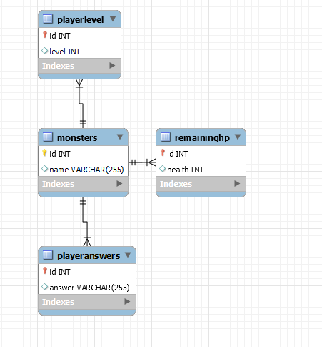
ERD

